Slide 1


Cloud Service Broker Platform
2014년 4월 30일
호텔 리베라 (서울)
ETRI 클라우드컴퓨팅연구부 강 동 재

Slide 2
Contents
01
Background
02
State of Art of CSB
03
ETRI CSB - AnyBroker
04
Usage Scenarios
05
Conclusion
Notes:
(택) 04번 삭제 영향 조정

Slide 3


Background – AS IS
Cloud and Cloud services are more and more increasing
  The trends is expected to be faster and faster
Cloud service customer and provider’s concerning…
  This concern is more bigger as cloud sites are increased
WHAT & WHRER is
best cloud service
for my requirements?
Provider F
Provider E
?
Provider D
HOW can I increase
Usage rate and
Business revenue?
Cloud Service Consumer
Should contact to
Every each cloud…
■
Quality
requirements
・
Availability
Provider C
(operating ratio):
99.9%
・
Communication
quality(QoS):
Guaranteed
bandwidth
Security:
Critical
Provider B
Provider A
Cloud Service Provider

Slide 4


Background – TO BE
Cloud service consumer can easily search and request best-matching cloud services
Cloud service providers can increase revenue and easily find customers
Provider F
Provider E
■
Quality
■
Quality
requirements
Quality
requirements
・
Availability
■
・
Availability
(operating ratio):
requirements
(operating ratio):
99.9%
Availability
99.9%
・
Communication
・
・
Communication
quality(QoS):
(operating ratio):
quality(QoS):
Guaranteed
■
Quality
Guaranteed
bandwidth
requirements
99.9%
bandwidth
Security:
・
Availability
・
Communication
Security:
(operating ratio):
quality(QoS):
99.9%
・
Communication
Guaranteed
quality(QoS):
bandwidth
Open
Cloud
Market
Provider D
Guaranteed
bandwidth
Security:
Critical
Security:
■
Quality
requirements
・
Availability
Consumer
(operating ratio):
!
99.9%
・
Communication
quality(QoS):
Guaranteed
Quality
bandwidth
Load balancing ?
Enhancement of service delay ?
High Availability ?
Open Cloud market ?
New service deployment ?
Nearest Cloud(Location) ?
Best security support ?
Cheapest Resources support ?
…
■
Security:
requirements
・
Availability
(operating ratio):
99.9%
Provider C
・
Communication
quality(QoS):
Guaranteed
bandwidth
Security:
■
Quality
requirements
・
Availability
(operating ratio):
Provider B
99.9%
・
Communication
quality(QoS):
Guaranteed
bandwidth
Provider A
Security:

Slide 5









Cloud Brokerage
Cloud Service Broker for Open Cloud Market
Cloud
Consumer
Cloud Service Broker
Cloud Service Provider
Micro DC
Notes:
추진 전략 1페이지
프랑스 불
스마트노드
EASI-CLUDS optimis, ……
CAP
스마트노드협의회
방통위 베스트베트
과학원 윤찬현 그리드 브로커
추가로 스마트인터넷기술협의회 추가

Slide 6


State of the Art of CSB(1/2)
What is a Cloud Service Broker?
An entity that manages the use, performance and delivery of cloud services and negotiates relationships between Cloud Providers and Cloud Consumers.
A cloud service broker (CSB) is a type of service provider that plays an intermediary role in cloud computing.
CSBs make it easier, safer and more productive to navigate, integrate, consume, extend and maintain
cloud services, particularly when they span multiple, diverse cloud services providers.
One-point management of several cloud services in multiple Clouds

Slide 7

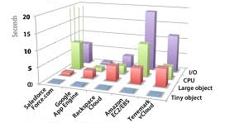
State of the Art of CSB(2/2)
Capabilities of a Cloud Service Broker
Service Intermediation
  Managing access to cloud services, identity management, performance reporting, enhanced security, …
Service Aggregation
  Combining and integrating
  multiple services into a new service
Service Arbitrage
  Making choices between available services,
  e.g. selecting the best according to
  consumer’s criteria
CSB
A Cloud Broker is similar to a travel agency: It provides a single consistent interface to multiple differing providers.

Slide 8
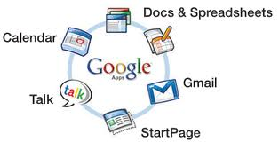


























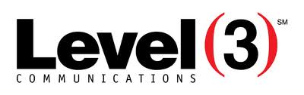
Market landscape
Software-
as-a-Service
(SaaS)
Platform-
as-a-Service
(PaaS)
Infrastructure-
as-a-Service
(IaaS)
Storage
Compute
Delivery

Slide 9















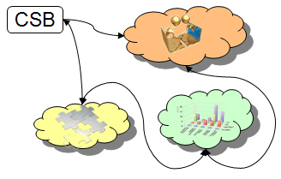
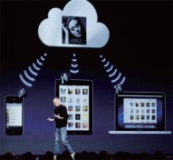

Industry Trend
Global Industry
Korea Industry
HA and Safety oriented Cloud service
Quantum
Easy-to-use Service
Cloud Consumer oriented Cloud service
SLA based Cloud Service
Cloud Provider oriented Cloud service
QoS guaranteed
Cloud Service
(Network, Mobile)
IaaS, PaaS, SaaS
Cloud Service
(CPU, Mem, Disk, PC)
Interoperability between Clouds
Computing Service Brokerage
Computing+Network Service Brokerage
Integrated Service Brokerage
Notes:
----------------------------------------------------------------------------------------
- 클라우드 사용자 중심과 서비스 중심 키워드의 차이점 고려

Slide 10
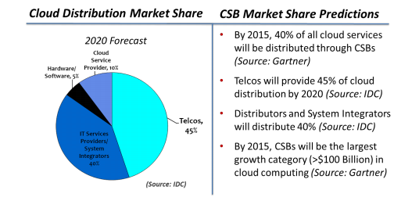
Market Expectation
Cloud Brokerage will become a HUGE Business…
Overall market potential of Cloud Brokerage
  2013: $1.57 Bn to 2018: $10.5 Bn
Cloud Brokerage Enablement
  Solution/ platform components as well as consulting services enabling brokerage market potential: 2013 $225.42 m/ 2018 $ 2.03 Bn
In 2015 40% of all cloud services will be provided through brokers
  More than 35 companies claim to be active in the cloud brokerage market already
  Various providers (like Jamcracker) offer dedicated solutions (e.g. platforms) enabling brokerage
Cloud distribution
– Market share
Figures for “cloud federation only” are hard to find (=practically non-existent).
Cloud computing utilization levels are “the best kept secret” in the business.

Slide 11
anyBroker
ETRI Cloud Service Broker

Slide 12



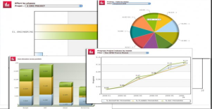
Objectives of Cloud service broker
broker services and resources from different Cloud providers
Simplify the utilization, development and management of secure, portable and scalable cloud services
Provide tailored SLA facilities
(for customer oriented Cloud service)
One-Point Cloud service management on multiple clouds
Enable new business models via real-time rating, charging, and revenue sharing
Notes:
추진 전략 1페이지
프랑스 불
스마트노드
EASI-CLUDS optimis, ……
CAP
스마트노드협의회
방통위 베스트베트
과학원 윤찬현 그리드 브로커
추가로 스마트인터넷기술협의회 추가

Slide 13
Vision
anyBroker
Any * | Description
Any Resource | Existing Computing Resource(CPU, Memory, Storagte), Network, Software
Any Service | IaaS, PaaS, SaaS
Any cloud | Supporting the connection to existing heterogeneous Clouds
Any SLA-based management & re-negotiation | SLA based service brokering and user-oriented management
Any marketplace | Supporting various business brokering marketplaces to increase revenue
Notes:
추진 전략 1페이지
프랑스 불
스마트노드
EASI-CLUDS optimis, ……
CAP
스마트노드협의회
방통위 베스트베트
과학원 윤찬현 그리드 브로커
추가로 스마트인터넷기술협의회 추가

Slide 14
Main Issues
Cloud Service Broker Supporting Service Brokering and Integrated Management of heterogeneous & distributed Clouds
1
Service Brokering
of distributed Clouds
2
SLA based
Service Management
3
Biz-Ready
Service Broker
Heterogeneous Clouds brokerage
(Open Source Clouds, Commercial Clouds)
One-point Management and Control (Computing & Network resources in distributed Clouds)
SLA based Cloud Service intermediation
User Req. based best-matching service provisioning
SLA based Service lifecycle management
Supporting Commercial Core functionalities (metering , reporting , invoice, …)
User management across multiple Clouds
Cloud Service Security
Development Strategies
Utilize 3rd party commercial products for Biz-Ready part to enhance CSB usage chances in Biz
Cooperate CSB leading organizations(EU, OSS Community) for more maturity of results

Slide 15

High-level Architecture
Cloud Service Customer
CSB Administrator
Cloud Service Provider
Automation
Access Control
Broker Portal
Cloud Service Registry
(for CSP)
User Requirement Verification
Flexibility
Commercialization Support
SLA based Negotiation and Selection Best-fit Cloud
Intelligence
Cloud #1
Service Management and Control
Cloud Connection Management
…..
Service Provisioning
Context Store
Monitoring
(Service, Resource, SLA, Security, …)
Security
Cloud #N
Notes:
추진 전략 1페이지
프랑스 불
스마트노드
EASI-CLUDS optimis, ……
CAP
스마트노드협의회
방통위 베스트베트
과학원 윤찬현 그리드 브로커
추가로 스마트인터넷기술협의회 추가

Slide 16
Design Overview
Cloud Service Broker
Business Support
Cloud Service Operating Information Management
Broker Portal API
Customer Management
Broker Information Repository
User Management and Security
Cloud Service Registry
User Requirement Verification
Metering and Invoice
Cloud Service Negotiation and Brokering
Reporting
SLA based Service Negotiation
SLA based Best-fit Resource Exploration
Service Lifecycle Management
Service Management and Control
Service Provisioning
Service and Resource Monitoring
Cloud Connection Management
Cloud Common Interfaces
Cloud specific Interfaces #1
Cloud specific Interfaces #N
Notes:
추진 전략 1페이지
프랑스 불
스마트노드
EASI-CLUDS optimis, ……
CAP
스마트노드협의회
방통위 베스트베트
과학원 윤찬현 그리드 브로커
추가로 스마트인터넷기술협의회 추가

Slide 17
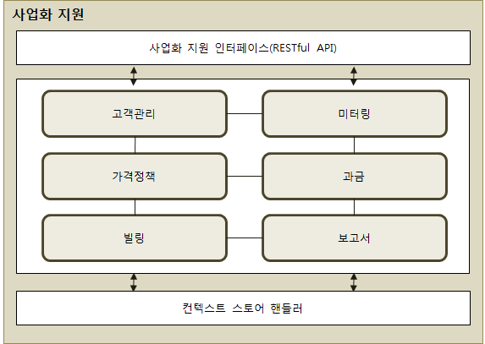
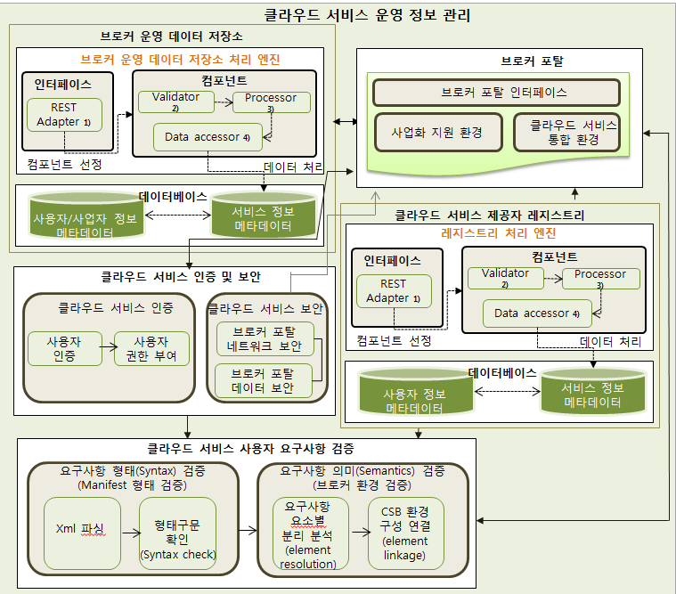
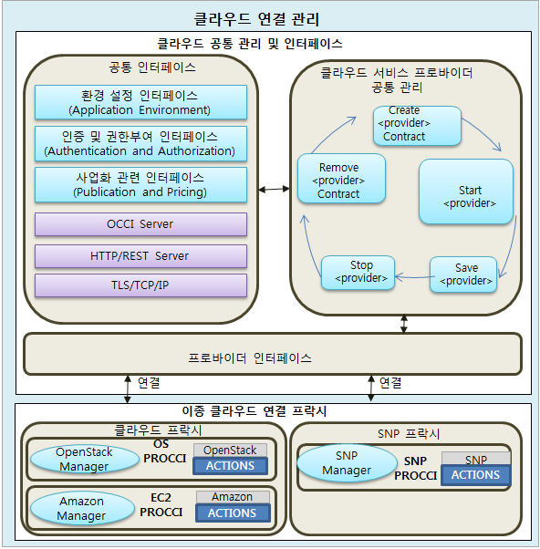
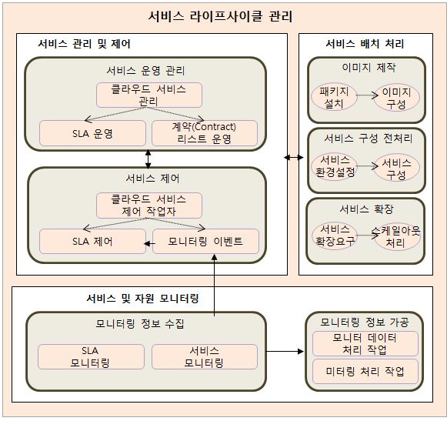
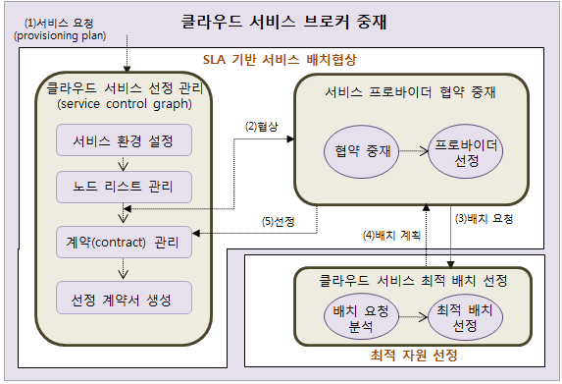
Design Details
Cloud Service Customer
CSB Administrator
Cloud Service Provider
Notes:
추진 전략 1페이지
프랑스 불
스마트노드
EASI-CLUDS optimis, ……
CAP
스마트노드협의회
방통위 베스트베트
과학원 윤찬현 그리드 브로커
추가로 스마트인터넷기술협의회 추가

Slide 18
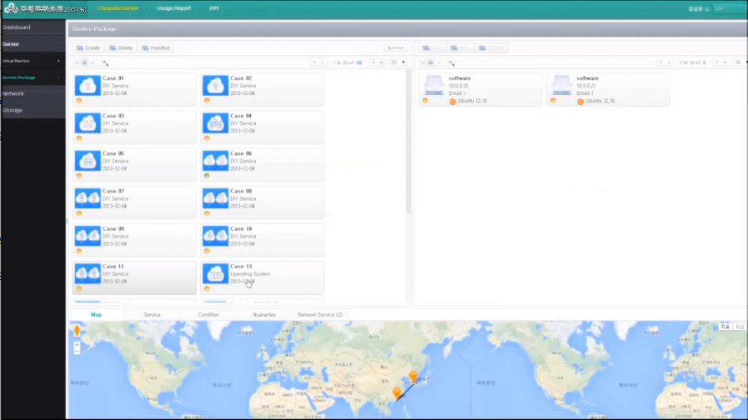
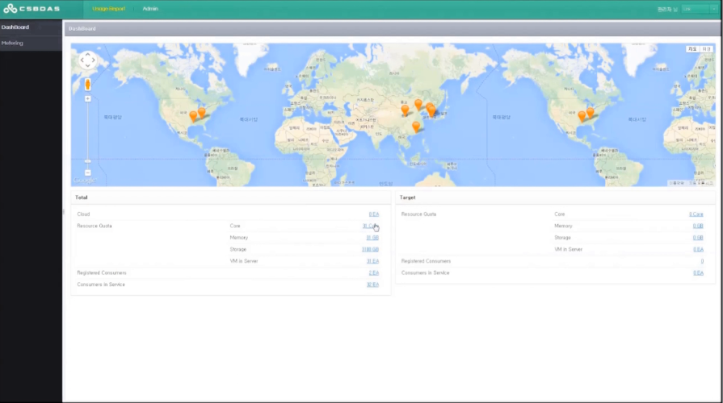
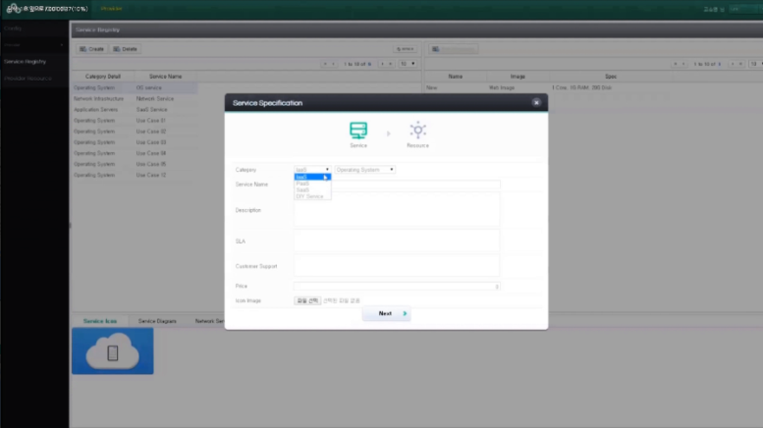
Portals of CSB
3 portals in CSB
CSB portal
CSC portal
Handling consumer’s requirement
and managing provider’s services
Managing consumer’s services
(e.g. service lifecycle)
CSP portal
Registering provider’s services

Slide 19

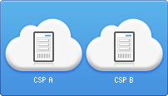
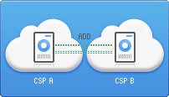

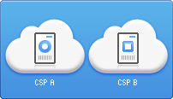


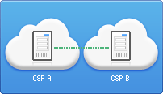

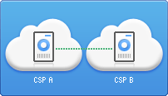

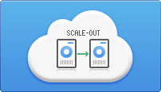
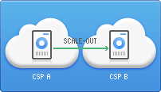


Service models in technical aspect
1
6
11
2
7
12
3
8
Package service(eg, WAS, ERP, …)
4
9
VM
5
10
Network
Application
scale-out

Slide 20
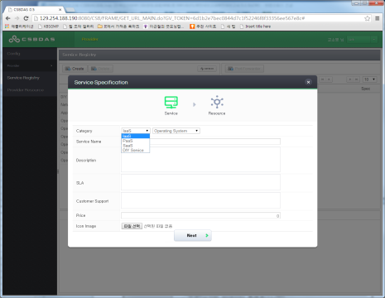
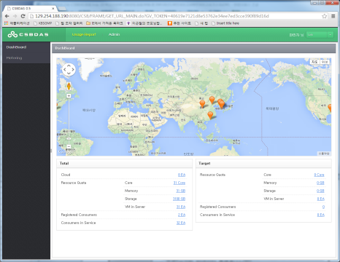
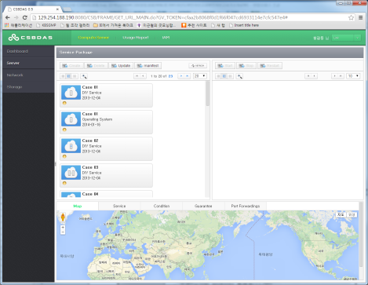
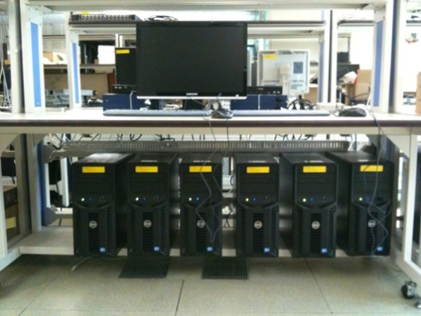
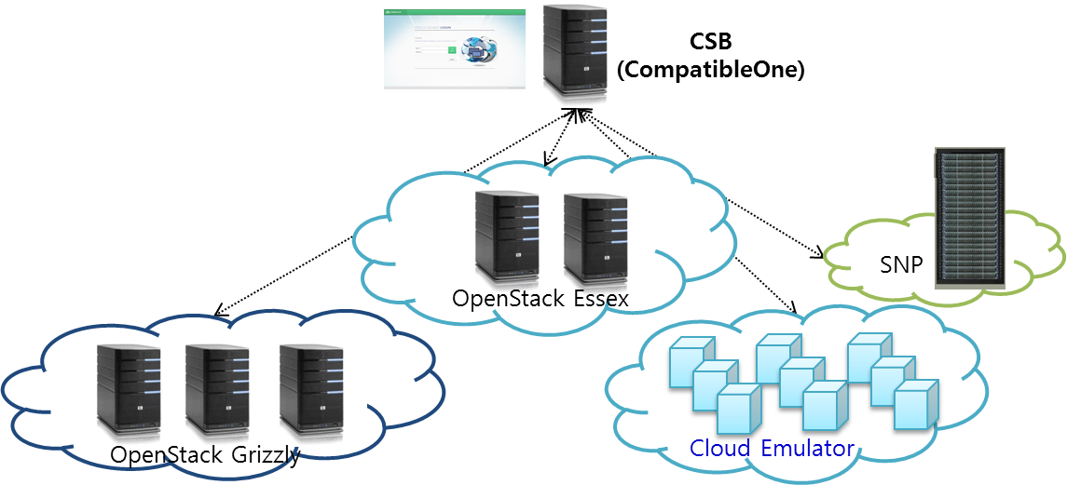


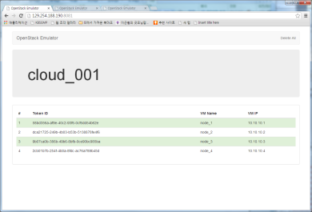
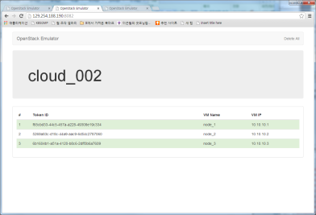
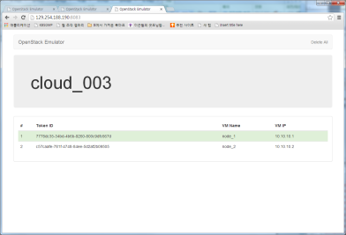
R&D Environment
CSP :Cloud Service Registration
CSB: Cloud Service Brokering/Management
CSC: Cloud Service Request/Usage
Cloud Service Broker
Micro DC

Slide 21










Integration Plan (2014~2016)
Open Innovation Networking Platform
Smart Networking Services
Cloud Service Broker
Service Brokering
and Provisioning
SDN
Service Data Transfer
Micro DC
Micro DC
스마트
노드
스마트
노드
Service Operating Infrastructure
Mobile
Mobile
Residential
Residential
Enterprise
Enterprise

Slide 22
Development Plan (2014 ~ 2016)
2013
2014
2015
2016
2017
Service
coverage
Compute Service
Support
Compute + Network
Service Support
Integrated Service
/ Stabilization
Network Service
Design
Design
Integration
Environment
coverage
Micro DC +
SDN Device
+ Micro DC
+ Micro DC+
SDN Device +
Public Cloud
No SLA support
SLA based *
Evaluation /
Stabilization
Technology
coverage
VM Oriented
Brokering
Service Oriented
Brokering

Slide 23



Use Case(1/2)
Streaming Content Service over CDN via CSB
CSB Portal
Content Provider
Service
Operation &
Mgmt
Backup Path
Provisioning
For Failover
Request
CDN Service
POP Provisioning
Request/Response
Considering
Traffic Congestion
Cloud
Resource
Request
CDN Service
Provider
CDN
POP(A)
CDN
POP(C)
CSB
Service Provider
CDN
POP(B)
Cloud
Registration
Contents File Storage
Contents Download/Service VM

Slide 24

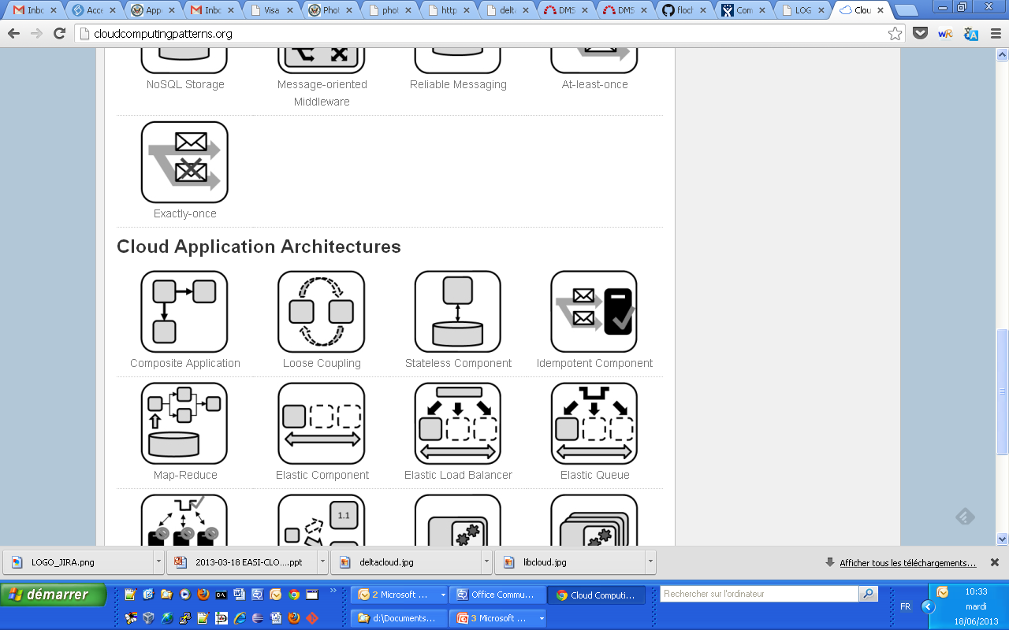
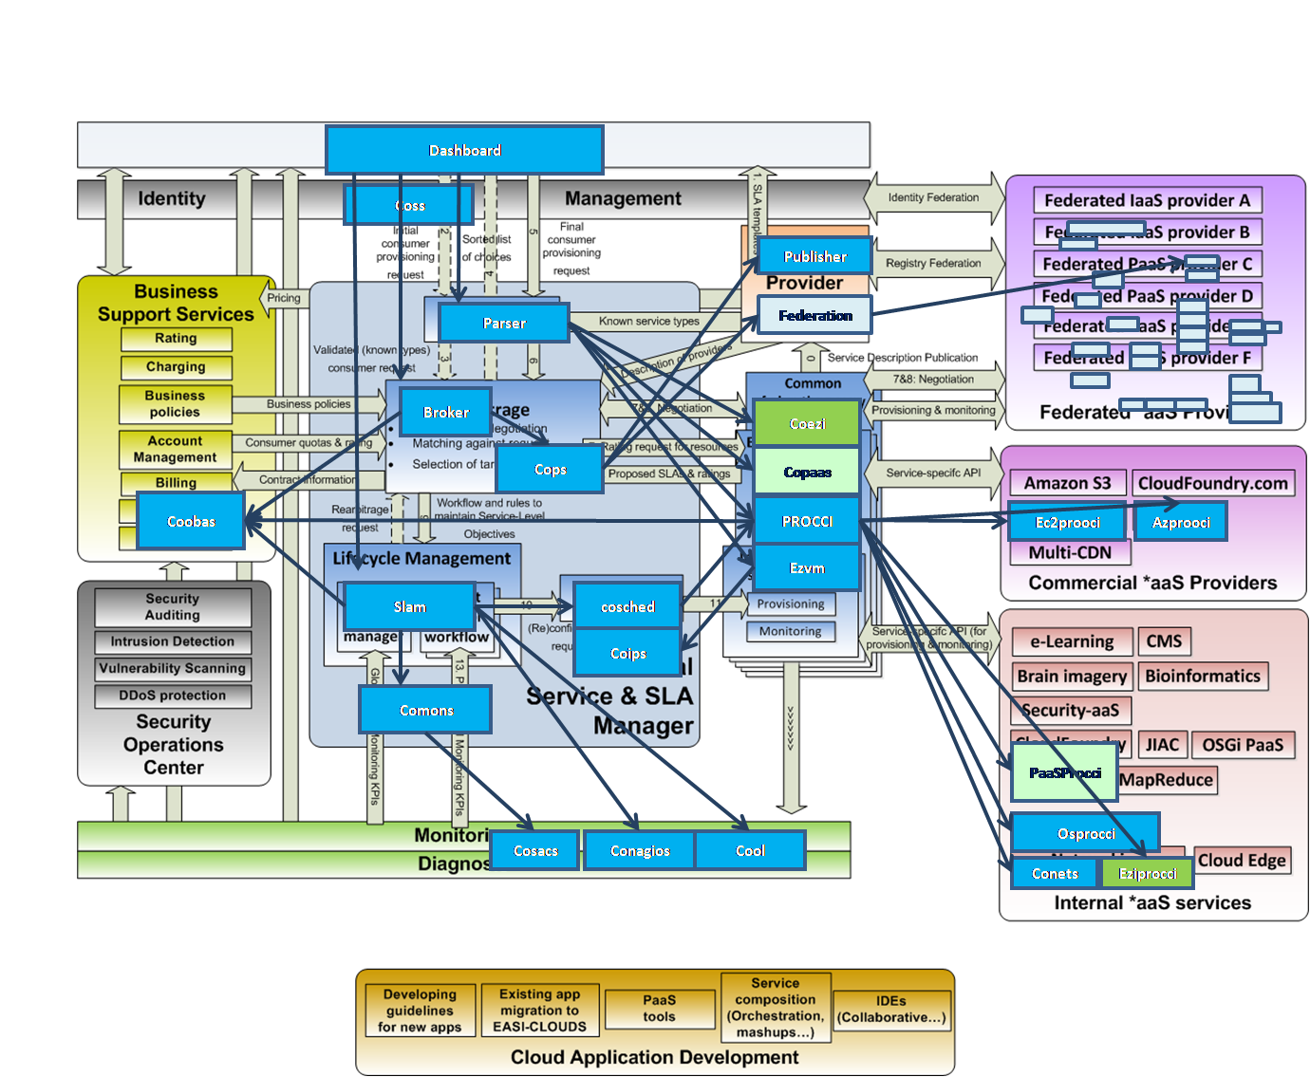
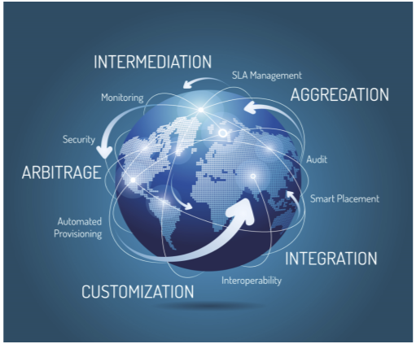
Architecture Choices
We are not reinventing the wheel
  CompatibleOne for Cloud Service Broker(CSB)
  OpenStack for Cloud Management Platform(CMP)
http://www.compatibleone.org/bin/view/Main/
http://www.openstack.org/
Notes:
추진 전략 1페이지
프랑스 불
스마트노드
EASI-CLUDS optimis, ……
CAP
스마트노드협의회
방통위 베스트베트
과학원 윤찬현 그리드 브로커
추가로 스마트인터넷기술협의회 추가

Slide 25
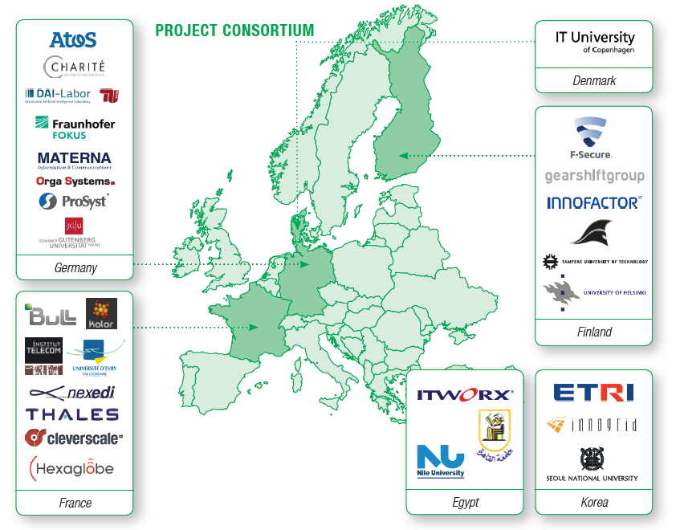
Cooperative Partners Status
Notes:
추진 전략 1페이지
프랑스 불
스마트노드
EASI-CLUDS optimis, ……
CAP
스마트노드협의회
방통위 베스트베트
과학원 윤찬현 그리드 브로커
추가로 스마트인터넷기술협의회 추가

Slide 26

Conclusions
anyBroker
  Builds on state-of-the art technology for cloud service brokerage and federation, combines that with advanced SLA and billing mechanisms.
  The target is an open ecosystem where computing and networking services can be traded in real-time.
  It provides freedom of choice for consumers and opportunities for small specialized providers.
anyBroker also develops new methods, technologies and competences to build various open cloud market.
Notes:
추진 전략 1페이지
프랑스 불
스마트노드
EASI-CLUDS optimis, ……
CAP
스마트노드협의회
방통위 베스트베트
과학원 윤찬현 그리드 브로커
추가로 스마트인터넷기술협의회 추가

Slide 27

업체소개
Thank you
Contact Information
djkang@etri.re.kr

